Slide 1
Cloud
Fundamentals

Slide 2
What is Virtualization
Key Concepts
What is Cloud Computing
Benefits of Cloud Computing
Cloud Services
Types of Cloud Computing
Cloud Solutions
Content

Slide 3

What is Virtualization?
Virtualization is technology that you can use to create virtual representations of servers, storage, networks, and other physical machines. Virtualization is a foundational technology for cloud computing that allows multiple virtual instances of a resource to operate on a single physical hardware system.
Concept: Virtualization is a process that allows a computer to share its hardware resources with multiple digitally separated environments. Each virtualized environment runs within its allocated resources, such as memory, processing power, and storage. With virtualization, organizations can switch between different operating systems on the same server without rebooting.

Slide 4
Virtualization: Key Concepts
1. Virtual machine: A virtual machine is a software-defined computer that runs on a physical computer with a separate operating system and computing resources. The physical computer is called the host machine and virtual machines are guest machines. Multiple virtual machines can run on a single physical machine. Virtual machines are abstracted from the computer hardware by a hypervisor.
2. Hypervisor: The hypervisor is a software component that manages multiple virtual machines in a computer. It ensures that each virtual machine gets the allocated resources and does not interfere with the operation of other virtual machines. There are two types of hypervisors.
a. Type 1 hypervisor: A type 1 hypervisor, or bare-metal hypervisor, is a hypervisor program installed directly on the computer’s hardware instead of the operating system. Therefore, type 1 hypervisors have better performance and are commonly used by enterprise applications. VM uses the type 1 hypervisor to host multiple virtual machines on the Linux operating system. (e.g., VMware ESXi, Microsoft Hyper-V)
b. Type 2 hypervisor: Also known as a hosted hypervisor, the type 2 hypervisor is installed on an operating system. Type 2 hypervisors are suitable for end-user computing. Runs on top of an existing operating system (e.g., VMware Workstation, Oracle VirtualBox).

Slide 5
What is Cloud Computing?
“
Cloud computing is a model for delivering computing services, including servers, storage, databases, networking, software, analytics, and intelligence, via the Internet. This model enables faster innovation, flexible resource utilization, and cost efficiencies by leveraging the vast resources of cloud providers.
“

Slide 6


Top benefits of Cloud Computing
Cloud computing is a big shift from the traditional way businesses think about IT resources. Here are seven common reasons organizations are turning to cloud computing services:
Cost
Moving to the cloud helps companies optimize IT costs. This is because cloud computing eliminates the capital expense of buying hardware and software and setting up and running onsite datacenters—the racks of servers, the round-the-clock electricity for power and cooling, and the IT experts for managing the infrastructure. It adds up fast.
Speed
Most cloud computing services are provided self service and on demand, so even vast amounts of computing resources can be provisioned in minutes, typically with just a few mouse clicks, giving businesses a lot of flexibility and taking the pressure off capacity planning.

Slide 7


Top benefits of Cloud Computing
Global scale
The benefits of cloud computing services include the ability to scale elastically. In cloud speak, that means delivering the right amount of IT resources—for example, more or less computing power, storage, bandwidth—right when they’re needed, and from the right geographic location.
Productivity
Onsite datacenters typically require a lot of “racking and stacking”—hardware setup, software patching, and other time-consuming IT management chores. Cloud computing removes the need for many of these tasks, so IT teams can spend time on achieving more important business goals.

Slide 8



Top benefits of Cloud Computing
Performance
The biggest cloud computing services run on a worldwide network of secure datacenters, which are regularly upgraded to the latest generation of fast and efficient computing hardware. This offers several benefits over a single corporate datacenter, including reduced network latency for applications and greater economies of scale.
Reliability
Cloud computing makes data backup, disaster recovery, and business continuity easier and less expensive because data can be mirrored at multiple redundant sites on the cloud provider’s network.
Security
Many cloud providers offer a broad set of policies, technologies, and controls that strengthen your security posture overall, helping protect your data, apps, and infrastructure from potential threats.

Slide 9
Cloud
Services

Slide 10
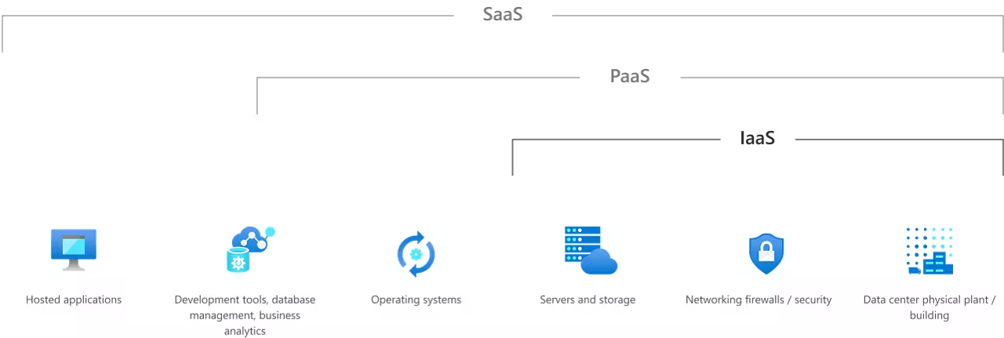
Cloud Services: IaaS, PaaS, serverless and SaaS
Most cloud computing services fall into four broad categories: infrastructure as a service (IaaS), platform as a service (PaaS), serverless, and software as a service (SaaS). These are sometimes called the cloud computing "stack" because they build on top of one another. Knowing what they are and how they’re different makes it easier to accomplish your business goals.

Slide 11
Cloud Computing Models
On Premises
Infrastructure
(as a Service)
Platform
(as a Service)
Software
(as a Service)
You Manage
You Manage
You Manage
Managed By Microsoft
Managed By Microsoft
Managed By Microsoft

Slide 12
Cloud Services: IaaS
Infrastructure as a service (IaaS) is a type of cloud computing service that offers essential compute, storage, and networking resources on demand, on a pay-as-you-go basis. IaaS is one of the four types of cloud services, along with software as a service (SaaS), platform as a service (PaaS), and serverless.
The most basic category of cloud computing services. With Infrastructure as a service (IaaS), you rent IT infrastructure—servers and virtual machines (VMs), storage, networks, operating systems—from a cloud provider on a pay-as-you-go basis.

Slide 13
Cloud Services: IaaS
Migrating your organization's infrastructure to an IaaS solution helps you reduce maintenance of on-premises data centers, save money on hardware costs, and gain real-time business insights. IaaS solutions give you the flexibility to scale your IT resources up and down with demand. They also help you quickly provision new applications and increase the reliability of your underlying infrastructure.
IaaS lets you bypass the cost and complexity of buying and managing physical servers and datacenter infrastructure. Each resource is offered as a separate service component, and you only pay for a particular resource for as long as you need it.

Slide 14
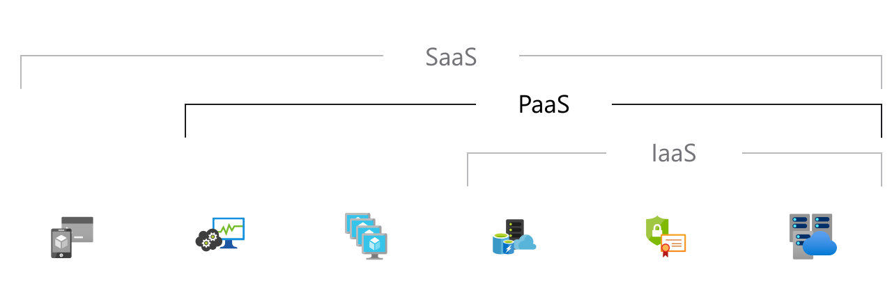
Cloud Services: PaaS
Platform as a service (PaaS) refers to cloud computing services that supply an on-demand environment for developing, testing, delivering, and managing software applications. PaaS is designed to make it easier for developers to quickly create web or mobile apps, without worrying about setting up or managing the underlying infrastructure of servers, storage, network, and databases needed for development.

Slide 15
Cloud Services: PaaS
Platform as a service (PaaS) is a complete development and deployment environment in the cloud, with resources that enable you to deliver everything from simple cloud-based apps to sophisticated, cloud-enabled enterprise applications. You purchase the resources you need from a cloud service provider on a pay-as-you-go basis and access them over a secure Internet connection.
Like IaaS, PaaS includes infrastructure—servers, storage, and networking—but also middleware, development tools, business intelligence (BI) services, database management systems, and more. PaaS is designed to support the complete web application lifecycle: building, testing, deploying, managing, and updating.
PaaS allows you to avoid the expense and complexity of buying and managing software licenses, the underlying application infrastructure and middleware, container orchestrators such as Kubernetes, or the development tools and other resources. You manage the applications and services you develop, and the cloud service provider typically manages everything else.

Slide 16
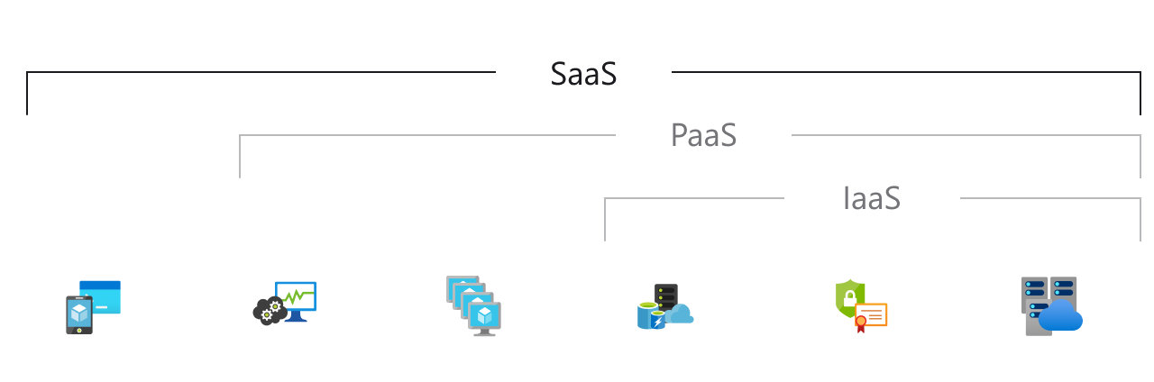
Cloud Services: SaaS
Software as a service (SaaS) is a method for delivering software applications over the internet, on demand and typically on a subscription basis. With SaaS, cloud providers host and manage the software application and underlying infrastructure, and handle any maintenance, like software upgrades and security patching. Users connect to the application over the internet, usually with a web browser on their phone, tablet, or PC.
Software as a service (SaaS) allows users to connect to and use cloud-based apps over the Internet. Common examples are email, calendaring, and office tools (such as Microsoft Office 365).

Slide 17
Cloud Services: SaaS
SaaS provides a complete software solution that you purchase on a pay-as-you-go basis from a cloud service provider. You rent the use of an app for your organization, and your users connect to it over the Internet, usually with a web browser. All of the underlying infrastructure, middleware, app software, and app data are located in the service provider’s data center. The service provider manages the hardware and software, and with the appropriate service agreement, will ensure the availability and the security of the app and your data as well. SaaS allows your organization to get quickly up and running with an app at minimal upfront cost.

Slide 18
Cloud Services: Serverless Computing
Serverless computing enables developers to build applications faster by eliminating the need for them to manage infrastructure. With serverless applications, the cloud service provider automatically provisions, scales, and manages the infrastructure required to run the code.
Overlapping with PaaS, serverless computing focuses on building app functionality without spending time continually managing the servers and infrastructure required to do so. The cloud provider handles the setup, capacity planning, and server management for you. Serverless architectures are highly scalable and event-driven, only using resources when a specific function or trigger occurs.

Slide 19
Cloud Computing
Types

Slide 20
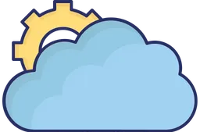
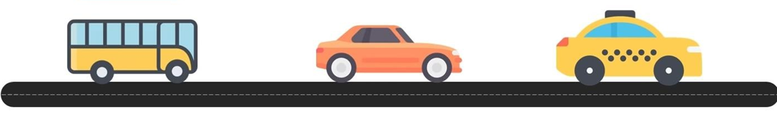
Types of Cloud Computing
PUBLIC
CLOUD
PRIVATE
CLOUD
HYBRID
CLOUD
Accessible to everyone
Owned By a
Single Person
Rent a Private Taxi

Slide 21
Public Cloud Computing
Public clouds are owned and operated by a third-party cloud service providers, which deliver their computing resources like servers and storage over the Internet. Microsoft Azure is an example of a public cloud. With a public cloud, all hardware, software and other supporting infrastructure is owned and managed by the cloud provider. You access these services and manage your account using a web browser.
In a public cloud, you share the same hardware, storage and network devices with other organisations or
cloud “tenants,” and you access services and manage your account using a web browser. Public cloud deployments are frequently used to provide web-based email, online office applications, storage and testing and development environments.
Advantages of public clouds:
Lower costs—no need to purchase hardware or software and you pay only for the service you use.
No maintenance—your service provider provides the maintenance.
Near-unlimited scalability—on-demand resources are available to meet your business needs.
High reliability—a vast network of servers ensures against failure.

Slide 22
Private Cloud Computing
A private cloud consists of cloud computing resources used exclusively by one business or organization.
The private cloud can be physically located at your organization's on-site datacenter or it can be hosted
by a third-party service provider. But in a private cloud, the services and infrastructure are always
maintained on a private network and the hardware and software are dedicated solely to your organization.
In this way, a private cloud can make it easier for an organization to customize its resources to meet
specific IT requirements. Private clouds are often used by government agencies, financial institutions, any
other mid- to large-size organizations with business-critical operations seeking enhanced control over
their environment.
Advantages of a private cloud:
More flexibility—your organization can customize its cloud environment to meet specific business needs.
More control—resources are not shared with others, so higher levels of control and privacy are possible.
More scalability—private clouds often offer more scalability compared to on-premises infrastructure.

Slide 23
Hybrid Cloud Computing
A hybrid cloud is a type of cloud computing that combines on-premises infrastructure—or a private cloud— with a public cloud. Hybrid clouds allow data and apps to move between the two environments.
Many organizations choose a hybrid cloud approach due to business imperatives such as meeting regulatory and data sovereignty requirements, taking full advantage of on-premises technology investment or addressing low latency issues.
The hybrid cloud is evolving to include edge workloads as well. Edge computing brings the computing power of the cloud to IoT devices—closer to where the data resides. By moving workloads to the edge, devices spend less time communicating with the cloud, reducing latency and they are even able to operate reliably in extended offline periods.
Advantages of the hybrid cloud:
Control—your organization can maintain a private infrastructure for sensitive assets or workloads that require low latency.
Flexibility—you can take advantage of additional resources in the public cloud when you need them.
Cost-effectiveness—with the ability to scale to the public cloud, you pay for extra computing power only when needed.
Ease—transitioning to the cloud does not have to be overwhelming because you can migrate gradually— phasing in workloads over time.

Slide 24
Cloud
Solutions

Slide 25
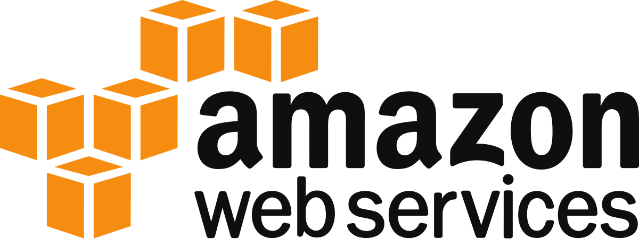
CLOUD SOLUTIONS
AWS
Amazon Web Services (AWS), launched in 2006, is the market leader in cloud computing, offering a comprehensive and widely adopted cloud platform.
AWS provides an extensive range of services, including EC2 for compute, S3 for storage, RDS for databases, and Lambda for serverless computing, among many others.
Its strengths lie in its extensive service offerings, robust security, and global reach, with numerous data centers around the world. AWS is particularly well-regarded for its strong enterprise support, making it a top choice for businesses of all sizes.

Slide 26

CLOUD SOLUTIONS
AZURE
Introduced in 2010, Microsoft Azure is a close competitor to AWS and is known for its seamless integration with Microsoft products.
Key services offered by Azure include Virtual Machines for compute, Azure Blob Storage for storage, Azure SQL Database for databases, and Azure Functions for serverless computing.
Azure's strengths include its ability to integrate seamlessly with Windows Server, Active Directory, and other Microsoft products, as well as its hybrid cloud capabilities and strong presence in the enterprise market.

Slide 27
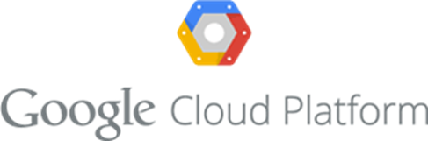
CLOUD SOLUTIONS
GCP
Google Cloud Platform (GCP), launched in 2008, is renowned for its data analytics and machine learning capabilities.
GCP offers key services such as Compute Engine for compute, Cloud Storage for storage, BigQuery for big data, and Cloud Functions for serverless computing.
GCP stands out due to its superior data analytics and machine learning tools, cost-effective pricing, and strong emphasis on open-source technologies and containerization. These strengths make GCP a preferred choice for businesses focusing on data-driven applications and innovation.

Slide 28
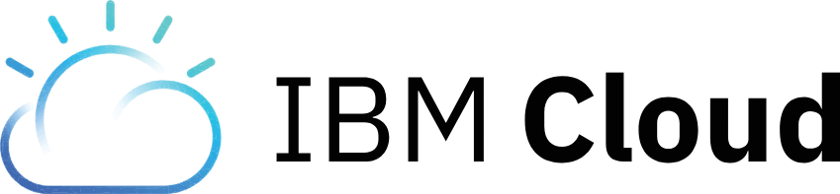
CLOUD SOLUTIONS
IBM Cloud
IBM Cloud provides both platform as a service (PaaS) and infrastructure as a service (IaaS), catering to enterprise solutions.
Key services include IBM Cloud Functions for serverless computing, IBM Cloud Object Storage, and IBM Db2 on Cloud for databases.
IBM Cloud's strengths are its advanced AI and machine learning capabilities, particularly through Watson, its robust hybrid cloud offerings, and its enterprise-friendly solutions. IBM Cloud is well-suited for organizations looking for powerful AI tools and hybrid cloud environments.

Slide 29
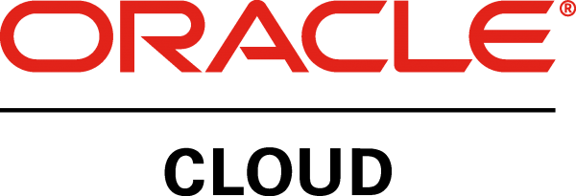

CLOUD SOLUTIONS
Other Cloud Providers
Digital Ocean: Popular among developers for simplicity and cost-effectiveness, focusing on small to medium-sized businesses.
Oracle Cloud: Oracle Cloud focuses on enterprise solutions, particularly databases. Key Services: Oracle Cloud Infrastructure (OCI), Oracle Autonomous Database, Oracle Cloud Applications. Powerful database services, strong security features, enterprise resource planning (ERP) capabilities.

Slide 30
Happy
Learning

